Slide 1
SQL Tutorial

Slide 2
MORE COMPLEX QUERIES

Slide 3
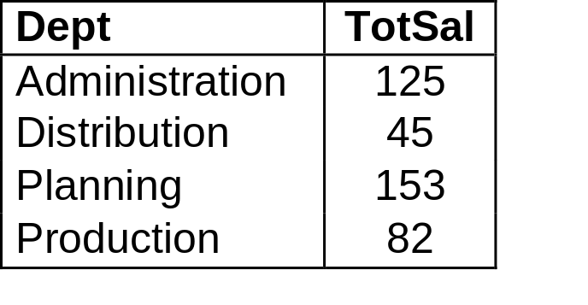
Example: GROUP BY
Employee(FirstName, Surname, Dept, Office, Salary, City)
Department(DeptName, Address, City)
"Find the sum of salaries of all the employees of each department":
SELECT Dept, sum(Salary) as TotSal
FROM Employee
GROUP BY Dept
Result:

Slide 4
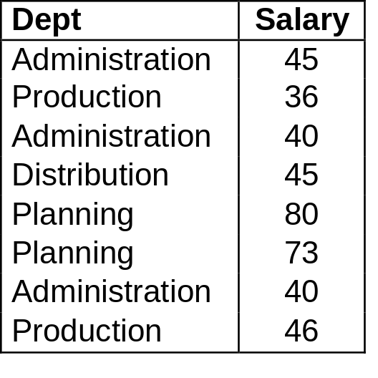
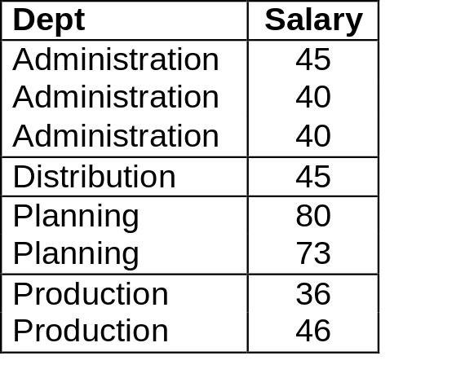
Example: GROUP BY Semantics
GROUP BY Processing:
the query is executed without GROUP BY and without aggregate operators
SELECT Dept, Salary as TotSal
FROM Employee
… then the query result is divided in subsets characterized by the same values for the GROUP BY attributes (in this case, Dept):
Finally, the aggregate operator sum is applied separately to each group

Slide 5
GROUP BY in practice
GROUP BY
is useful for retrieving information about a group of data
(If you only had one product of each type, it won’t be that useful)
is useful when you have many similar things
(if you have a number of products of the same type, and you want to find some statistical information like the min, max, etc.)
SQL technical rules:
The attribute(s) that you GROUP BY must appear in the SELECT
GROUP BY must list all non-aggregate attributes used in SELECT
Remember to GROUP BY the column you want information about and not the one you are applying the aggregate function on

Slide 6
GROUP BY in practice (cont.)
Incorrect query:
SELECT Office
FROM Employee
GROUP BY Dept
Incorrect query:
SELECT DeptName, D.City, count(*)
FROM Employee E JOIN Department D ON (E.Dept = D.DeptName)
GROUP BY DeptName
Correct query:
SELECT DeptName, D.City, count(*)
FROM Employee E JOIN Department D ON (E.Dept = D.DeptName)
GROUP BY DeptName, D.City
Notes:
There could be several office values for each dept value (eg, look at Administration). An aggregation function should be applied. Moreover, Dept should appear in SELECT.
Second query actually makes sense, but SQL does not allow it (because it does not check to see that deptname is a key for Department, and therefore there is only one value for City). Instead, one has to write the query the way shown at the bottom. In short, All the non-aggregate attributes that appear in SELECT have to appear in the GROUP BY clause.

Slide 7

Example: HAVING
Employee(FirstName, Surname, Dept, Office, Salary, City)
Department(DeptName, Address, City)
"Find which departments spend more than 100 on salaries":
SELECT Dept
FROM Employee
GROUP BY Dept
HAVING sum(Salary) > 100
Result:

Slide 8
HAVING in practice
If a condition refers to an aggregate function, put that condition in the HAVING clause. Otherwise, use the WHERE clause.
You can't use HAVING unless you also use GROUP BY.
"Find the departments where the average salary of employees working in office number 20 is higher than 25":
SELECT Dept
FROM Employee
WHERE office = ‘20’
GROUP BY Dept
HAVING avg(Salary) > 25

Slide 9
EXERCISE
Notes:
Work on this exercise by yourself at home to practice before the midterm.
I will post sample answers by end of next week.

Slide 10
Exercise
Professor(Id, Name, DeptId)
Course(CrsCode, DeptId, CrsName, Description)
Teaching(ProfId, CrsCode, Semester)
Note: Values for Semester are YYYY (F | S | W), e.g., '2006F', '2005W‘
Questions:
“Find the names of all professors who taught in Fall 2004”
“Find the names of all courses taught in Fall 2005, together with the names of professors who taught them”
“Find the average number of courses taught by professors in Comp. Sc. (CS)”
“Find the number of courses taught by each professor in Comp. Sc. (CS)”
“Find the number of courses taught by each professor in Comp. Sc. (CS) in 2008”

Slide 11
Answers
Professor(Id, Name, DeptId)
Course(CrsCode, DeptId, CrsName, Description)
Teaching(ProfId, CrsCode, Semester)
➔ “Find the names of all professors who taught in Fall 2004”
SELECT P.Name
FROM Professor P, Teaching T
WHERE P.Id=T.ProfId AND T.Semester='2004F'
“Find the names of all courses taught in Fall 2005, together with the names of professors who taught them”
SELECT C.CrsName, P.Name
FROM Professor P, Teaching T, Course C
WHERE T.Semester = '2005F' AND P.Id = T.ProfId AND T.CrsCode = C.CrsCode

Slide 12
Answers (cont.)
Professor(Id, Name, DeptId)
Course(CrsCode, DeptId, CrsName, Description)
Teaching(ProfId, CrsCode, Semester)
“Find the average number of courses taught by professors in Comp. Sc. (CS)”
SELECT count(CrsCode)/count(DISTINCT ProfId) AS avgCrsTaughtinCS
FROM Teaching T, Course C
WHERE T.CrsCode=C.CrsCode AND C.DeptId = 'CS'
“Find the number of courses taught by each professor in Comp. Sc. (CS)”
SELECT T.ProfId, count(*)
FROM Teaching T, Course C
WHERE T.CrsCode=C.CrsCode AND C.DeptId='CS'
GROUP BY ProfId

Slide 13
Answers (cont.)
Professor(Id, Name, DeptId)
Course(CrsCode, DeptId, CrsName, Description)
Teaching(ProfId, CrsCode, Semester)
"Find the number of courses taught by each professor in Comp. Sc. (CS) in 2008"
SELECT T.ProfId, count(*)
FROM Teaching T, Course C
WHERE T.CrsCode=C.CrsCode AND C.DeptId='CS' AND Semester LIKE '2008_'
GROUP BY ProfId

